Slide 1
Tzu-Chi Yen & Kristen Schneider

Slide 2
Notes:
https://www.planetnatural.com/pest-problem-solver/houseplant-pests/fungus-gnat-control/
Larvae: ¼ inch in length, shiny black head, elongated body that Is wither white or transparent. Abundant in damp, rich soils, and feed on organic matter (e.g. grass, fungus, mulch, mold, plant roots, etc.). Full lifespan == 3-4 weeks, but larvae have a 2 week life span, chew on plant roots.

Slide 3
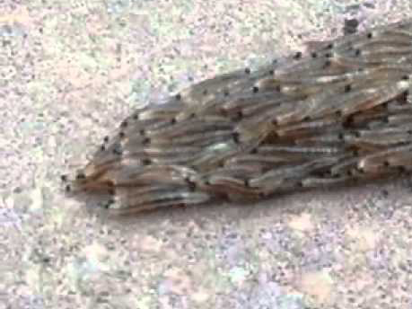
[https://www.dailymail.co.uk/sciencetech/article-2737816/Snakes- No-writhing-mass-hundreds-fungus-gnat-LARVAE-searching-shelter.html]
Notes:
Original video:
Large mass of fungus gnat larvae moving as a collective unit
With some split

Slide 4
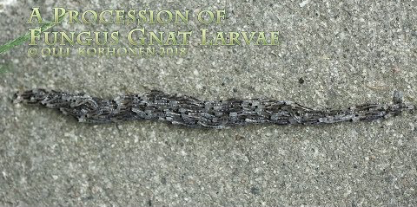
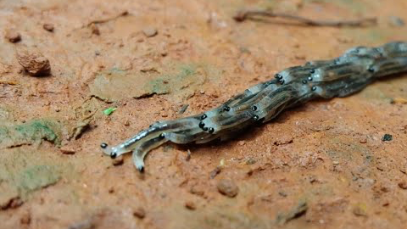
[https://www.youtube.com/watch?v=TU2Q8kVs0hU]
[https://www.youtube.com/watch?v=6MwYvLaJ6Ho]
Notes:
Other videos (more clear)
Leap frog motion seems to be more of a function of weight than a conscious decision…
The split doesn’t really happen in these videos, (starts in the top and then comes back together)
Travel in packs to look more like a snake so that birds don’t attack/eat them

Slide 5
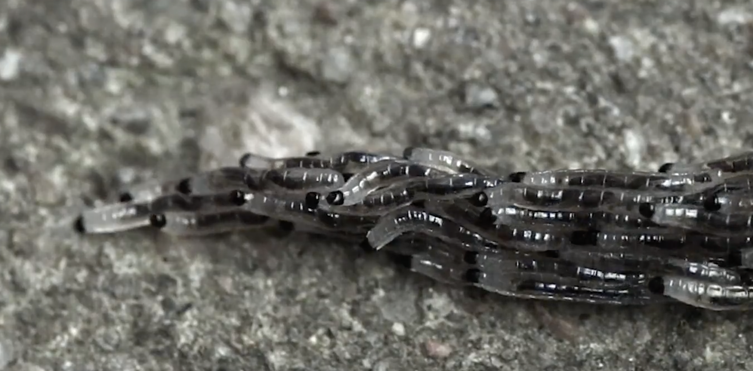
STACKED CRAWLING
Directionality influenced by:
Neighbors
Moisture
Forward motion influenced by:
Depth/weight
SPLITTING
Split influenced by:
Informed individuals
Moisture content
Weight threshold

Slide 7
Our implementation

Slide 8
Video Results?

Slide 9
Future Work
Mention Any bug fixes
Anything we talked about but haven’t implemented
new ideas:
Front agent picks next direction based on moisture
When “average weight” exceeds some amount, split
If no weight on top, move stochastically in all directions until you come into contact with another larva. Then move in that direction.

Slide 10
Acknowledgments

